Slide 1


Project Foodie.com

Slide 2
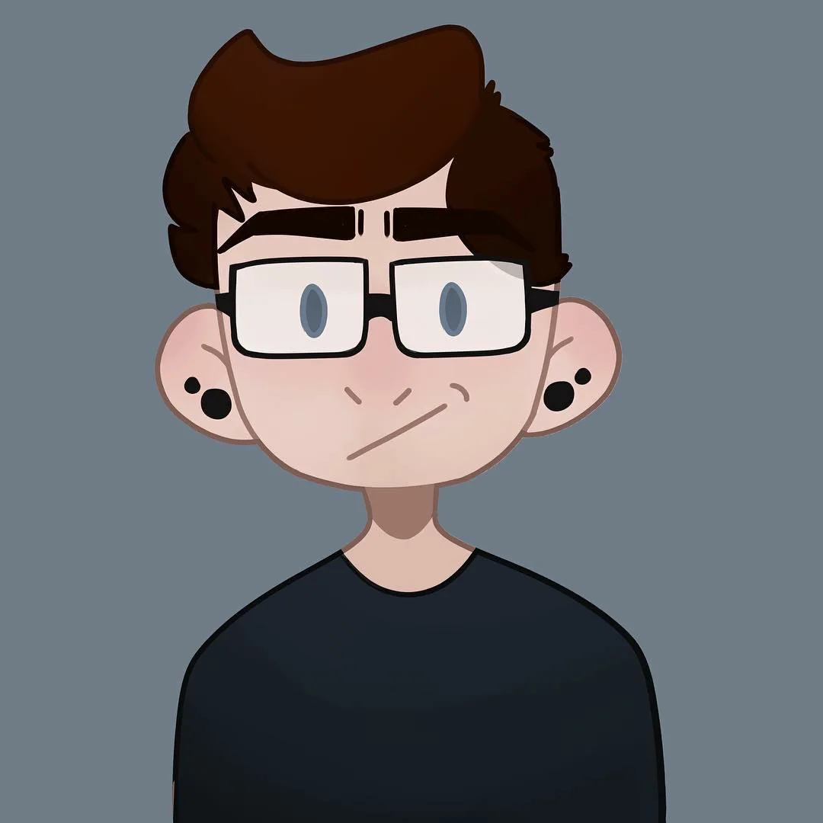
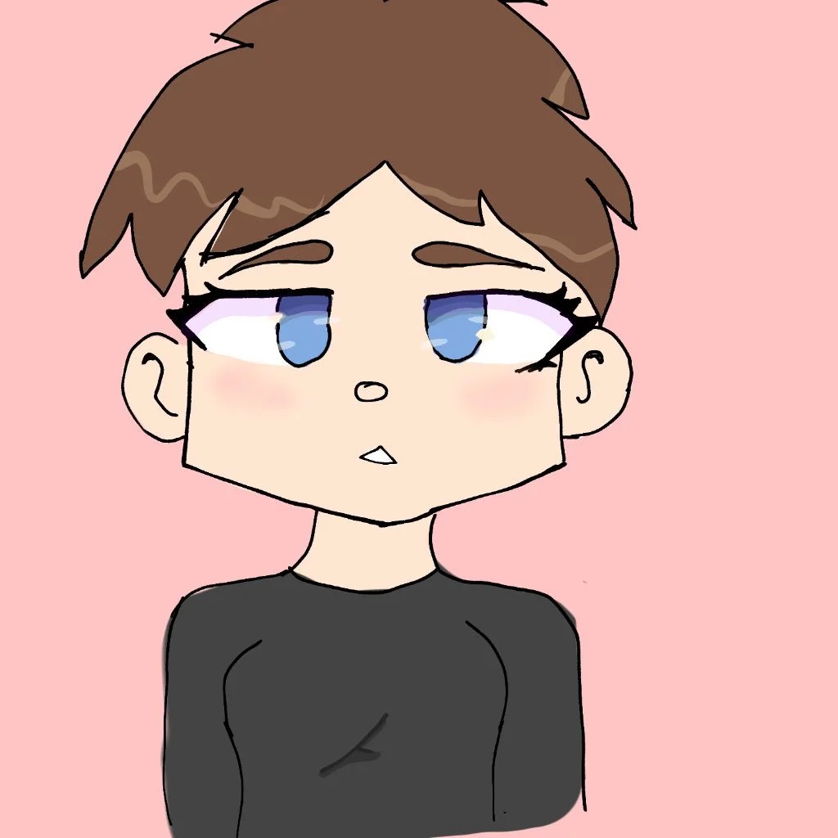

Team
Sanju
Evelyn
Aishna

Slide 3
Need of the project…
Problem : As we move on with the “New Normal” because of the Covid-19 situation. It has forced us to change some of our common behaviours. Enjoying our favourite food at our favourite restaurant is one of them…
At that time the COVID-19 pandemic has highlighted the importance of food delivery platforms in ensuring safety and minimizing contact. These platforms have played a crucial role in supporting social distancing measures by providing contactless delivery options.
Not Only this these platforms also supports small and local restaurant to reach a wider customer base. By ordering through these platforms you are also providing a direct support to these restaurants.

Slide 4
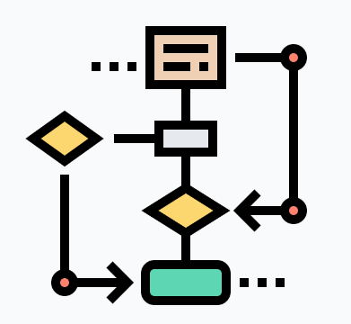







CONTENT
1. Introduction
4. Process Flow
7. Team
2. Features
5. UI Tour
8. Q&A
3. Technology
6. Future Scope

Slide 5
INTROCUCTION
Our project is a Food Application “Foodie” a dynamic website inspired by Zomato & Swiggy, The popular food discovery and delivery platform. Our website focuses on revolutionizing the way users explore and order food online. With an extensive restaurant database, detailed menus.
Our main focus is to provide our customer with healthy, hygienic and tasty food.
Our Platform facilitates two types of User i.e. Vendor and Customer.

Slide 6
FEATURES
We have tried to provide most of the essential functionalities to our customers and Vendor.
For Login customer and vendor need to go through authentication and validation process
Customer-:
Customer can add items to his favourite section. And from favourites he can Order or can delete that item.
Customer can Order multiple Food items from multiple restaurants.
Customer can also cancel that order.
Customer can View/Update his profile.
For Payment we have provided RazorPay API
Customer can search the item and restaurants
Vendor -:
Vendor can Add/Delete/Update Restaurants in the database.
Vendor can Add/Update Item In his Restaurant.

Slide 7
YES
START
User
Admin
Login
Register
Login
NO
NO
YES
View Items/Restaurants
Add/Update Restaurant
Add/Remove Items to Cart
Remove Restaurant
Add/Remove Items to Favourites
Add Item/Menu To Particular Restaurant
View Favourites/Orders
Update Item
Check Profile
Check Profile
Update Profile
Update Profile
Payment
Logout
STOP

Slide 8






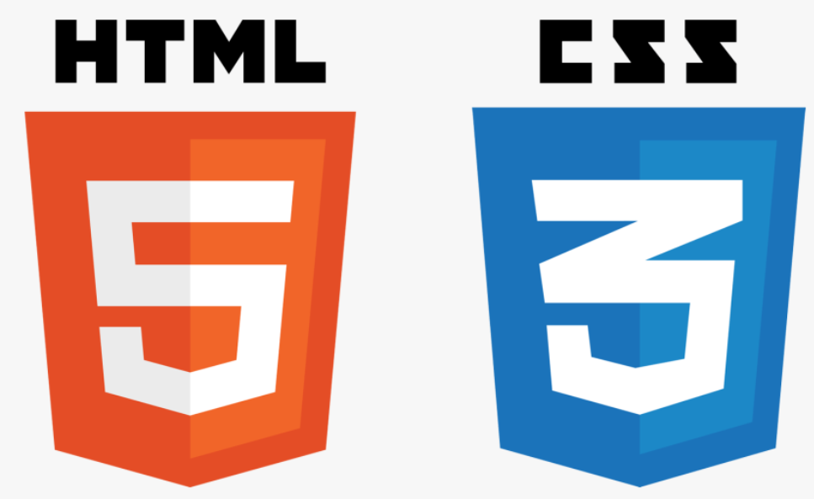


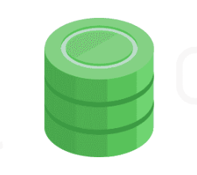


TECHNOLOGIES USED

Slide 9
Eureka Server
API
G
A
T
E
W
A
Y
Auth Service
Login
Feign Client
MySql DB
User Service
Angular
Add User
Client
Search/add
Restaurant Service
Mongo DB
Order
Order Service
Notification Service
Payment Service

Slide 10
DOMAIN/MODEL CLASSES
MICROSERVICES | MODEL CLASS | ATTRIBUTES
AuthService | User | email, password, name, phoneno, role, image
UserService | Address user FavItem | house no, landmark, street, city, pin email, password, name, phoneno, role, address, pfp, fav item itemId, itemName, itemPrice, itemRating, image
RestaurantService | FoodItems Restaurant | itemId, itemName, itemPrice, itemRating, description, image restaurantId, restaurantName, restaurantRating, location, image, food items
OrderService | Item Order | itemId, itemName, itemPrice, itemRating, image, count, status orderId, customerId, address, item
PaymentService | Payment order | orderAmount, orderInfo
NotificationService | Email | subject, body

Slide 11
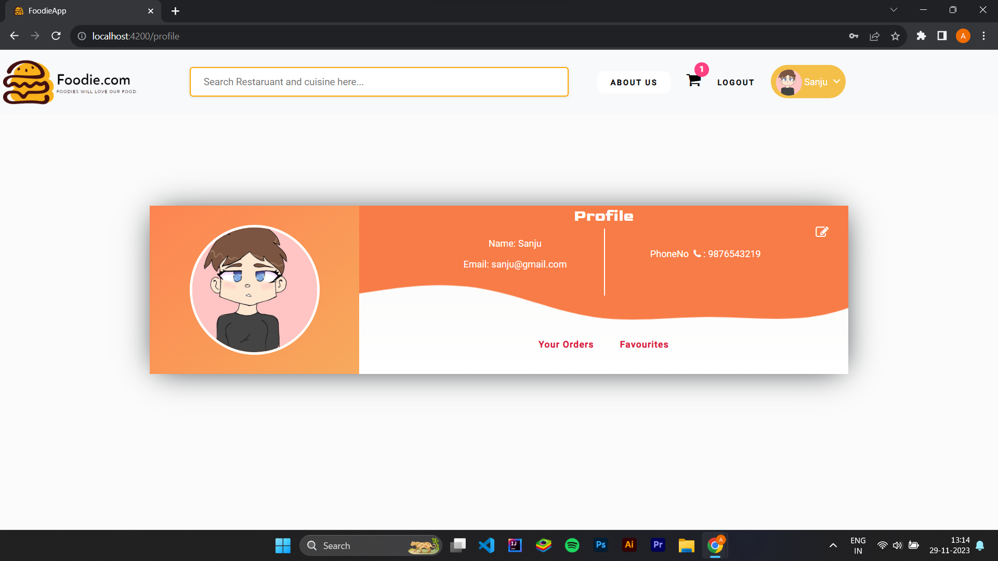
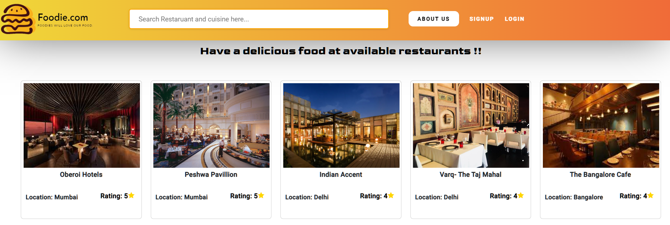
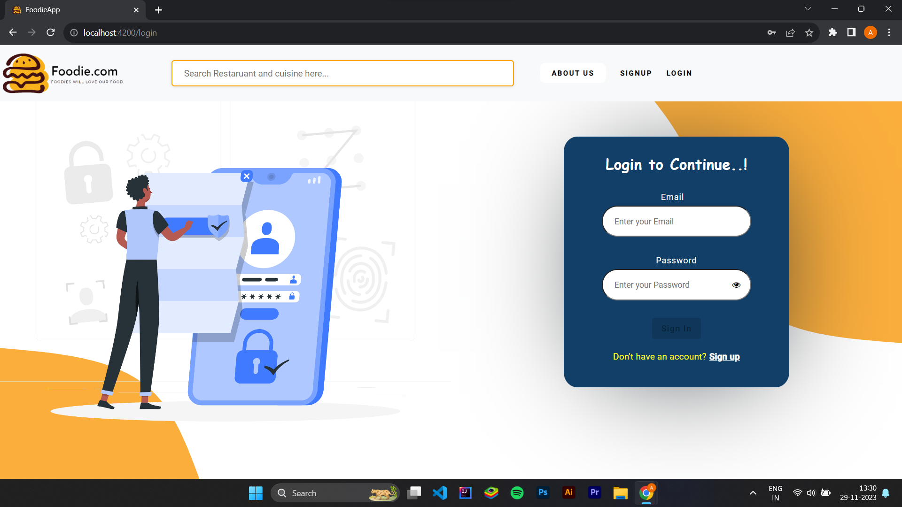
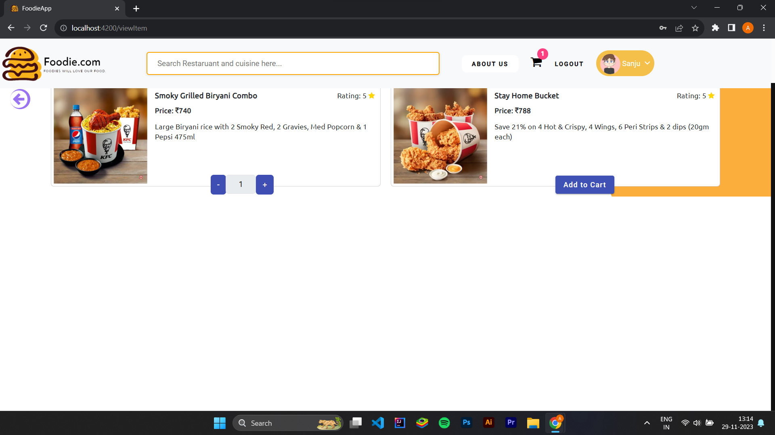
USER EXPERIENCE

Slide 12
FUTURE SCOPE
In coming time we are Planning to Provide Restaurant location, Using google maps Api and we’ll also try to provide new user a discount on his first order
We’ll also try to implement loyalty program – to encourage customer retention, where user will receive rewards on the basis of orders.
and also social media Integration as well, so if user wants to share something about the items/restaurants, they can share that on social media.

Slide 13
THANK YOU

